Slide 1
Defect Management

Slide 2
Objectives
  At the end of this module, you will be able to:
  Describe a Defect
  Explain the Defect Life Cycle
  State the differences between defect severity and defect priority
  List the steps for Defect Logging
  Categorise defect information
  Explain effective Defect Reporting
  List the attributes of a good defect report

Slide 3


What is a Defect ?
A Software Engineer makes
an error ...
When the expected result
and the actual result do not
match….
… it is a defect ...
If not fixed… that can
cause a failure in operation..
Notes:
Before explaining this slide, Facilitator is requested to invite participants to write their ideas on the board.
Brainstorm Theme: “what hits me when I think of a ‘Defect’ ?”

Slide 4
Defect
  A Software Defect/Bug is a condition in a software product that does not meet a software requirement (as stated in the requirement specifications) or end-user expectations (that may not be specified but are reasonable).
  A defect can be related to code or it can be related to documentation as well.
  A problem, if not corrected, can cause an application to either fail or produce incorrect results.
    Examples:
  Incorrect computation of interest by a banking system
  Online payment system fails at the authorization step
  Altimeter in the flight indicates wrong altitude level to the Pilot
Notes:
Start with Example of Defect w.r.t. Financial applications.
A Customer goes to withdraw $1000 from his account having a balance of $5000 and minimum bank balance require is $500.
2. ATM Reject the request saying “Insufficient Balance”
Amount withdrawn and printed amount shows difference.

Slide 5

Why find Defects?
  Increase confidence in the quality of the system
  Reduce the likelihood of loss or even life-threatening incidents
  Obtain repeat and referral business from satisfied customers
  Decrease overall system costs associated with quality problems
Notes:
Ask questions to the audience or trainee then show this slide.

Slide 6


Impact of Defects
  A single error can cause nothing or a lot
    It can cause death or injury if it fails in case of safety critical applications.
    It can also cause huge financial losses to clients.
    It can lead to fine/penalties for us.
  NYSE fined Waterhouse Investor Services US $225,000 for its web site failures - inability to file on-line stock orders and inadequate customer service

Slide 7


Impact of Defects – Latest Example
    An AA jet crashed in Columbia because the captain entered an incorrect one-letter computer command that sent the jet into a mountain killing 158 people aboard.
    A hacker hacked into the US government computers, including two agencies within the Defense Department, and defaced government web sites.
Notes:
The first example express the usability problem
When there is critical command, the software could have asked for confirmation or verified or have enough validation before processing the command
Second example show the insufficient Security Testing

Slide 8


Legal Implications
  Defects in a product can also attract penalties to the producer or supplier.
  E.g.: Famous hot coffee case against McDonalds
  Under a contract, a buyer can sue a company if he/she does not get what he/she paid for or if the software performs functions that it was not supposed to.
  A buyer can also sue for damages - economic loss or injury to person or property, caused due to error or a defect in the product.

Slide 9
Defect Life Cycle and Categorisation
  It helps management to prioritise and turn around faster delivery of the product.
  It helps to identify the high risk area in the product.
  This kind of grading helps developers in fixing those defects first, that are critical.
  Following are the parameters generally used in categorisation of a Defect.
  Defect Severity
  Defect Priority
  Defect Types
  Phase found in
  Root cause
New
Assign
Rejected
Open
Deferred
Resolved
Reopened
Test
Verified
Closed

Slide 10
Defect Severity
  Defect Severity signifies the degree of impact that the defect has on the development or operation of a component application being tested. It is the extent to which the defect can affect the software. The severity type is defined by the Software Tester based on the written test cases and functionality.
      Critical - This defect causes system failure. No testing can proceed further. It may also be called a show stopper.
      Major - This is a highly severe defect that causes the system to collapse. However, a few parts of the system are still usable, and/or there are a few workarounds for using the system in the collapsed state too.
      Minor - This is a defect that causes some undesirable behavior; however, the system and features are still usable to a high degree.
      Trivial - This is more of a cosmetic issue. No serious impediments to the system functionality are noted.
Notes:
Fatal: Show Stoppers.
1. This could cause serious failure in the system.
2. Defect due to which review process cannot be continued & has to be terminated.
Major:
Defect that would result in failure of the software element(s) or an observable departure from specs. (SRS/Design Doc./Func. Specs/Prog. Specs
Minor:Cosmetic
Defect that would affect only the non-functional aspects of the software elements

Slide 11
Defect Priority
Defect priority signifies the level of urgency of fixing the defect. In other words, priority means how fast/how soon it has to be fixed. Though priority may be initially set by the Software Tester, it is usually finalised by the Project/Product Manager.
      Immediate - The defect must be resolved immediately
      High - This defect must be fixed in any of the upcoming builds but must be included in the release
      Medium - This defect must be repaired after serious defects have been fixed
      Low - It can be resolved in a future major system revision or not be resolved at all

Slide 12
Differences between Defect Severity and Defect Priority
Severity | Priority
Severity is associated with standards/functionality. | Priority is associated with scheduling.
Severity refers to the seriousness of the defect on the functionality of the product. Higher effect on the functionality will lead to assignment of higher severity to the defect. | Priority refers to how soon the defect should be fixed.
Generally, the Quality Assurance Engineer decides the severity level. | Priority to fix a defect is decided in consultation with the client/manager.

Slide 13
Example of Severity and Priority
Think of the following type of problem:
A spelling error on a user-interface screen. What severity and priority does this issue deserve?
Well, judging from our earlier definitions, it would seem that this is a low-severity item. After all, the server doesn’t crash due to a spelling error.
But is this truly a low-severity problem?
A spelling error will probably not hinder a customer’s ability to use the system, but it greatly affects the customer’s perception of the company that created the product and of the quality of the product. So from customer-relations and corporate-image point of view, the severity of this type of issue is indeed high. But the severity field doesn’t allow us to express that properly. So the need for the priority field becomes apparent. The priority field does allow product management to define this issue as high priority, but this creates the case where something is low severity but high priority.

Slide 14
Example of Severity and Priority
Let us consider another case:
The anomalous server crash – we have all seen this type of issue (a server crash that occurs on the first full moon of every leap year but that is not reproducible by any human means on a consistent basis).
So, how would this issue be categorised within the defect tracking system?
Well, since it is a server crash, many would argue that it must be a high-severity issue. After all, the system is inoperable until the server is restarted. But what is the impact to the customer? In this case, the impact is quite small. Since the customer may never see this issue present at all in a production environment, it would be given a low priority and high severity by Product Management.

Slide 15



Defect types
DO – Documentation related defects
This includes all defects related to missing or misstated
requirement in the functional specification.
BD/PK/LD - Build/Package/Load
Change management, library, version
control
FN/LO (Coding)
Function/Program Logic (Logic, pointers, loops, recursion,
computation); Not functioning as per the design/requirement.
Notes:
DO – Missing requirement in Functional Specification but software working correctly. Design or BRD not updated.
BD/PK/LD - Problem in the build, missing file etc..which leads to failure of software while installation or after installation

Slide 16
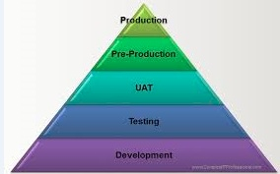


Defect types Contd..
EN - Environment
Environment (Design, compile, test, or other support
system problems)
OP
If the optimal usage is lacking or performance is not
up to the mark, the design will adversely affect the product's performance.
SG – Suggestion
If the defect reported is a suggestion which would be taken as an enhancement
Notes:
DO – Missing requirement in Functional Specification but software working correctly. Design or BRD not updated.
BD/PK/LD - Problem in the build, missing file etc..which leads to failure of software while installation or after installation

Slide 17

Defect Management
A good Defect Management process helps to gather and manage information during each defect workflow i.e. from initial discovery to final resolution or deferral.

Slide 18

Defect Logging
Defect logging is a process of finding defects in the application under test(AUT) or product by testing or recording feedback from customers and making new versions of the product that fix the defects or the clients feedback.
Examples – JIRA, Mantis, Hp Quality Center, Bugzila, IBM Rational Quality Manager
Get the empty defect template.
Specify available information; keep updating the template as the information becomes available
Categories of Defect Information
    General information
    Defect detection information
    Resolution information
    Status information
Notes:
Again change the sequence of slides. Logging of defect should be before defect resolution

Slide 19

1. General Information
Basic information on nature of defect, its repair priority, etc. :
  Description - brief text
  Priority (immediate, high, medium, low)
  Severity (critical, major, minor)
  Cause keywords (for further analysis)
  Symptoms (database corruption, visible data wrong, cosmetic, etc.)
  Phase found in
  Date reported
  Actual date of closure

Slide 20

2. Defect Detection Information
Specify information about testing data related to defect, environment, who found it, etc.
  Description (Steps To Reproduce, Expected and Actual Result)
  Build, Log, Cycle, Procedure, Case
  “Reported by” Name, Company
  Hardware, Software - Platform on which defect found
  Test station
  Attached information
  Additional information

Slide 21
3. Resolution Information - Developer
How the defect was resolved – must be entered by developer
  Resolution from a codified list
  Fixed in build/version
  Resolution description
  Modified software - components modified to resolve defect
  Additional information
  Additional attachments

Slide 22

4. Status Information
Current status of a defect and status history
  Description
  Status history with rows containing
  Date
  Action
  Performed by
  Actual effort
  Resulting status
  Next step assigned to
  Estimated effort for next step
  Expected date of completion

Slide 23
Defect Tracking
Defect tracking is an important process in software engineering as complex and business critical systems have hundreds of defects. One of the challenging factors is managing, evaluating and prioritizing these defects. The number of defects get multiplied over a period of time and, to effectively manage them, the defect tracking system is used.
Summary Information on defects not yet closed
  Defect Identification (name / number)
  Date Reported
  Expected date of closure
  Severity
  Priority
  Current state
  Assigned to
Selection by “Assigned to”, “Priority”, or “Severity”, etc.
Sorting by various orders

Slide 24
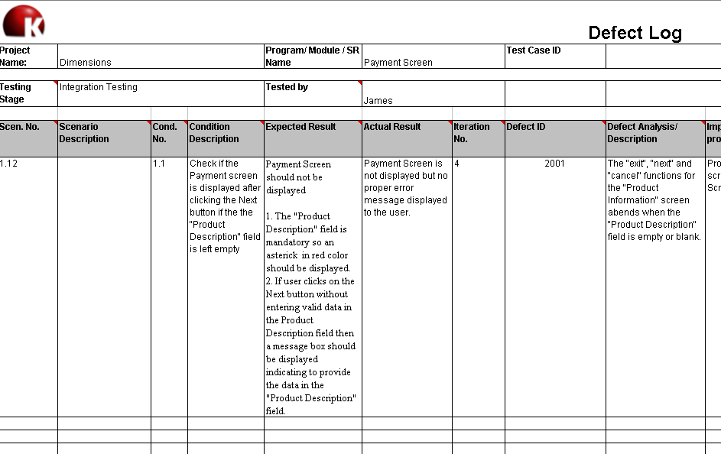
Defect Example
NOTE: * Defects can also be managed using Test Management or Defect Tracking Tools

Slide 25
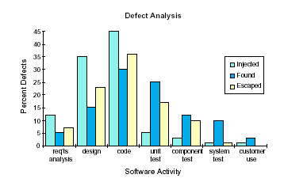
Defect Analysis
This chart shows the percentage of defects found during each testing phase. It helps in analysis of the effectiveness of different phases in SDLC.

Slide 26
Defect Analysis – Contd..
Defect Categorization
Missing Function
Memory
10%
5%
Syntax Error
Interface Error
40%
15%
Ambiguous
requirement
30%

Slide 27

Defect Management - Pitfalls
Many irreproducible defects
Retesting is a bottleneck
Same defect occurs again
Incomplete update of database
Lazy classification - everything classified as “others”
Defect data used to attack project personnel

Slide 28
Effective Defect Reporting
Defect reports are among the most important deliverables to come out of test. They are as important as the test plan and will have more impact on the quality of the product than most other deliverables from the test.
Effective defect reports will:
  Reduce the number of defects returned from development
  Improve the speed of getting defect fixes
  Improve the credibility of the test
  Enhance teamwork between test and development teams

Slide 29

Effective Defect Reporting
Have you come across the following situations?
Defects reported are not clear/understood by the development team
  Very critical especially for independent test projects
  Defects reported are rejected by the development team because:
  The defects reported are not clear
  There is need for more information to reproduce the problem
  Defect data is inaccurate to generate metrics.
  Defects reported are not the defects in the system.
  Defect reports are too complex to understand.
  Some testers get better responses from the development team. Why?

Slide 30

Importance of Effective Defect Reporting!!
From the Development Perspective
  Real Defects in the system/program
  Clear but brief information about the defect
  Steps to easily reproduce the problem
  Proper description of the problems if they happened to be more general
  Developer must be able to isolate the problem reported
  Increased productivity – in fixing the problem with least amount of effort
  Expect reports that convey the correct message and simplify the process

Slide 31

Importance of Effective Defect Reporting!!
From the Test Perspective
    Reduce the defect life cycle
  Ensure that the defects get fixed by developers in the
  agreed timeframe
    Improve the credibility of the test
    Enhance teamwork between development and test
    Get better response from the development team
    (critical for Independent Test Projects)
    Reduce things like ‘Need more feedback’, ‘Works fine on my machine’

Slide 32

Importance of Effective Defect Reporting!!
From the Management Perspective
Improve productivity
Get accurate information on the defects reported
Reduce the time to market
Get the correct metrics
Take proper actions in timely resolution of the defects

Slide 33
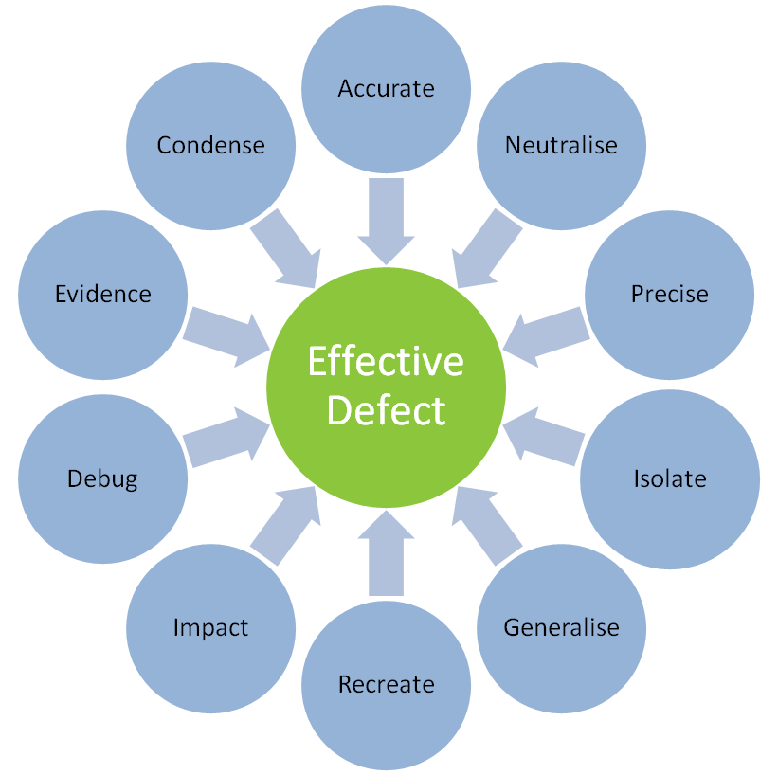
Attributes of a good Defect Report

Slide 34
1. Condense
Say it clearly but briefly
Eliminate unnecessary wordiness, extraneous information
Include relevant information
Condense
Incorrect
I was setting up a test where the real intent was to detect memory errors. In the process, I noticed a GUI field that I was not familiar with. I decided to exercise the field. I tried many boundary and error conditions that worked just fine. Finally, I cleared the field of any data and attempted to advance to the next screen. Several retries reveal that anytime there is no data in the "Product Description" field, you cannot advance to the next screen.
Correct
The "exit", "next" and "cancel" functions for the "Product Information" screen abends when the "Product Description" field is empty or blank.

Slide 35
2. Accurate
Be extremely sure that what you are reporting is really a defect
Don’t lose credibility by reporting wrong defects
Do your homework before you write a problem
Check with the developer or Senior tester before reporting
Accurate
Ask questions like:
Is there something in the setup that could have caused this? Could this be a result of a network or an environmental problem? Do you really understand how this is supposed to work?
Notes:
Notes :
- Check with developer or senior tester before reporting.
- Don't be afraid to report problems. Do your best to ensure they are valid problems.

Slide 36
3. Neutralise
State the problem objectively.
Don’t use humor or emotionally charged zingers.
Even if defects are rejected, provide more information that will be helpful to the developer. This will help in credibility in the long run.
Neutralise
Incorrect
As could have been determined from the original defect with very little effort, function ABC does indeed abend with any negative value as input.
Correct
Function ABC abends with any negative value. Examples of some values tested include -1, -36, -32767
Notes:
Even if defects are returned back provide more information that will be helpful to the developer. This added bit of professionalism will give you respect and credibility in the long run
What you think funny may not be interpreted funny by the developer who is working overtime and is stressed with deadlines
They just create barriers to communication and teamwork.

Slide 37
4. Precise
The person need not be a detective to determine what the problem is.
Describe clearly what you perceive the problem to be.
Write in such a way that the problem cannot be misunderstood
Precise
Incorrect
Issuing a Cancel Print when a job is in PRT state (job is already in the printer and AS/400 is waiting to receive the print complete from printer) causes the Twin ax port to not timeout. The printer never returns to a READY state and indefinitely displays "PRINTING IPDS FROM TRAY1" in the op-panel In the above description, it is difficult to identify whether the problem is Twin ax port not timing out Printer not returning to ready The message displayed on the op-panel
Correct
Precede the description with a small summary, for e.g. canceling a job while it is printing causes the printer to hang. Then describe the problem.
Notes:
Additional Notes for the facilitator:
Conduct small exercises on defect reporting skills.
Explain importance of writing defect description in as precise as possible manner. Sentences can be simple yet straight while defining the problem. Advise to avoid complex sentences, vocabulary, abbreviations and adjectives.

Slide 38
5. Isolate
Invest a reasonable amount of effort in isolating a problem.
Try to find out the shortest and easier steps to reproduce the problem.
Ask yourself if anything external to the code is causing the problem for e.g. network, and so on.
By doing an end-to-end testing, can you specify which exact component is causing the failure.
For testing multiple input conditions, vary the input condition until you find the value that triggered the problem.
Your ability to isolate in a large part defines your value-add as a tester.
Isolate
E.g. You found a problem while printing a postscript document. Even if you think the problem occurs while printing the postscript document, specify the exact document that you used for printing.

Slide 39
6. Generalise
Generalise
Fixes are made often, as per the problem reported.
Identify if it is a more general problem and needs a generic fix.
Incorrect
Date displayed on the Payment Screen is not in the format mm/dd/yy .
Correct
Date displayed on the Payment Screen, Batch Screen, Billing Summary screen is not in the format, mm/dd/yy

Slide 40
7. Re-create
If you can re-create the defect, you must explain clearly and concisely what is required to do re-create it.
List all steps, exact syntax, file name or sequences you en-counter to re-create the problem.
If you find more reliable and shorter methods while verifying/re-creating the defect, document it.
If you are not able to re-create the defect or suspect the same, gather all the relevant information and pass it on to the developers to see if they want to examine the system.
Re-create
Incorrect
Assume that the problem cannot be re-created if you haven’t verified that it can be re-created.
Correct
If you cannot or haven't re-created the problem, it is important to note that in the defect remarks.

Slide 41
8. Impact
What is the impact if the defect was to surface in the customer/production environment?
If you think that the defect will not get sufficient priority, then state the potential impact and sell the defect.
Don't oversell, but make sure that the readers understand the probable impact on the customer.
Impact
Notes:
Notes: e.g.
- System crashes when I hit the enter key
- You may notice a typo error on a window. It may be minor, but if that results to be an offensive word, then such typo errors need to be fixed

Slide 42
9. Debug
What will help the developer if he needs to debug the problem? Are there any traces, dumps, logs, etc. that must be captured and made available along with the defect report.
Provide correct pointers in the logs, dumps that will help the developer to resolve the defect as fast as possible.
Debug
Notes:
Explain why it is important to provide data that can help developers to debug.
Insufficient defect details can discourage the developer to investigate and in situations when time is not sufficient, Developers may discard the defect and/or reject it.

Slide 43
10. Evidence
What proves that the defect you report is an error? Have you provided both the expected and the actual results? Is there any documentation that supports your expected result?
Evidence may take the form of user guides, requirements, design, etc.
It also may be past comments from customers, de-facto standards, competing products.
Do not assume that everyone see things the same way as you do.
Do not assume that three weeks from now, you will remember why this was a defect.
Provide even more evidence when you think this situation may not be accepted as a defect.
Evidence

Slide 44
Summary
  In this module, you learnt about:
  Defect and Defect Life Cycle
  Differences between defect severity and defect priority
  Steps for Defect Logging
  Defect information categories
  Effective Defect Reporting
  Attributes of a good defect report

